Slide 1
Tutorial 11
Ziren
u4975835@anu.edu.au
Thursday 10 am to 11am
CBE 3.09

Slide 2
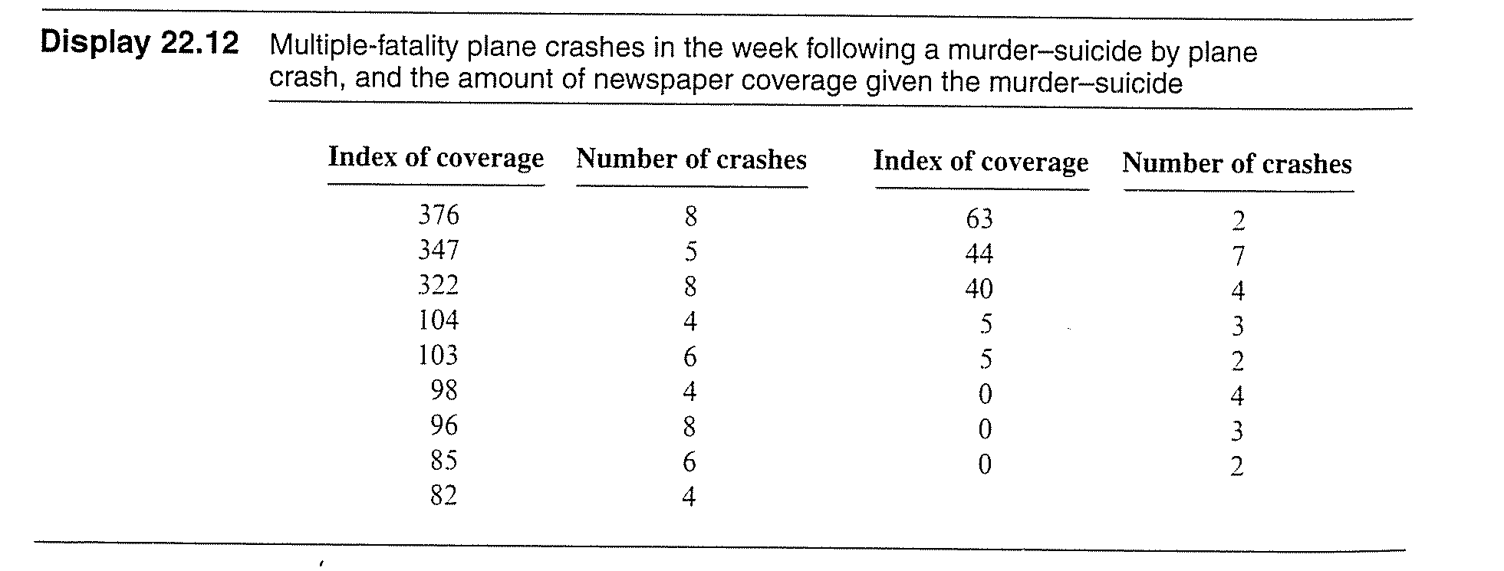
Question 1
Some sociologists suspect that highly publicised suicides may trigger additional suicides. In one investigation of this hypothesis, D.P. Phillips collected information about 17 airplane crashes that were known (because of notes left behind) to be murder-suicides. For each of these crashes, Phillips reported an index of the news coverage (circulation in nine newspapers devoting space to the crash multiplied by length of coverage) and the number of multiple- fatality plane crashes during the week following the publicized crash. The data are contained in “ex2216.csv”. Is there evidence that the mean number of crashes increases with increasing levels of publicity of a murder-suicide?

